Slide 1
INF805: Information Security
Dr. Regina Esi Turkson (PhD) (Dr. Mrs Regina Esi Segbefia)
Department of Computer Science and Information Technology University of Cape Coast

Slide 2
Disclaimer!
The lecture slides are partially collected from the Internet for educational purpose only. The lecturer does not claim any credit for them and the copyrights belong to the original authors.

Slide 3
OUTLINE
Block and stream cipher
Other examples of symmetric cryptosystem (DES, AES)
Principles of Public-Key Cryptosystems
Public-Key Cryptosystems
Applications for Public-Key Cryptosystems
Requirements for Public-Key Cryptography
Public-Key Cryptanalysis
The RSA algorithm
Description of the Algorithm
Computational Aspects
The Security of RSA

Slide 4
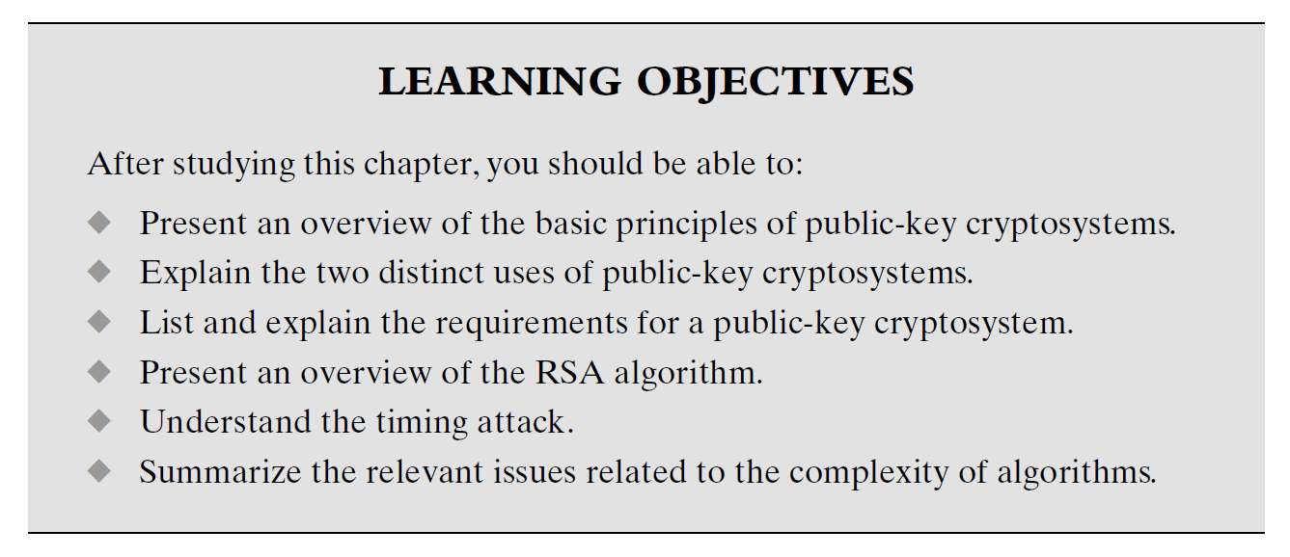

Slide 5
Block Cipher
When a block cipher is used for encryption and decryption purposes, the message is divided into blocks of bits.
64 bit block size is the most widely used.
A strong cipher contains the right level of two main attributes: Confusion and Diffusion
Confusion is commonly carried out through substitution whiles Diffusion is carried out by transposition.
For a cipher to be strong it must contain both Confusion and Diffusion attributes to ensure reverse-engineering is basically impossible.
The randomness of the key values and the complexity of the mathematical functions dictates the level of confusion and diffusion involved.

Slide 6
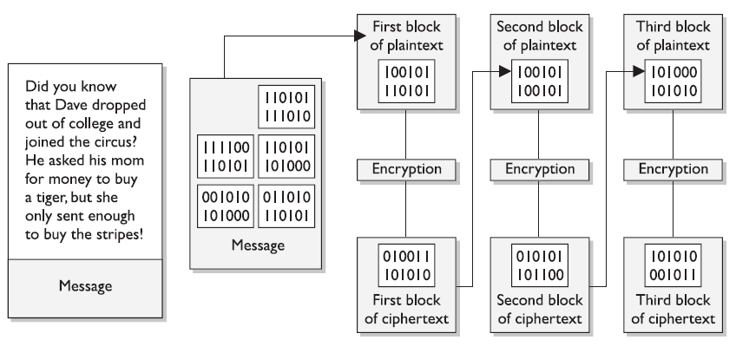
Block Cipher

Slide 7
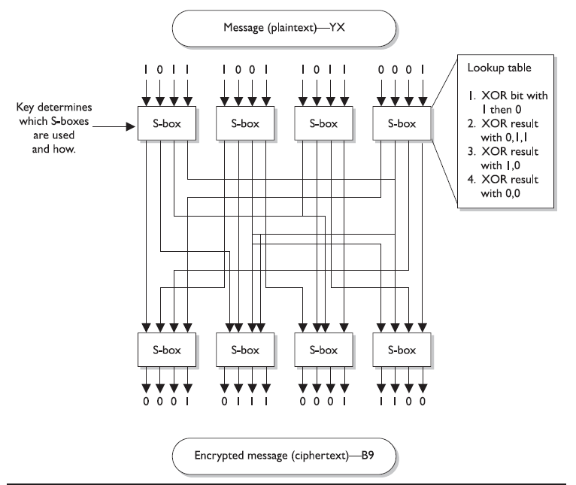
Block Cipher

Slide 8
Stream Cipher
A stream cipher treat message as a stream of bits and performs mathematical function on each bit individually.
Stream Cipher uses Keystream generator which produces a stream of bits that are XORed with the plaintext bits to produce ciphertext.
Easy for hackers to break. Why?

Slide 9
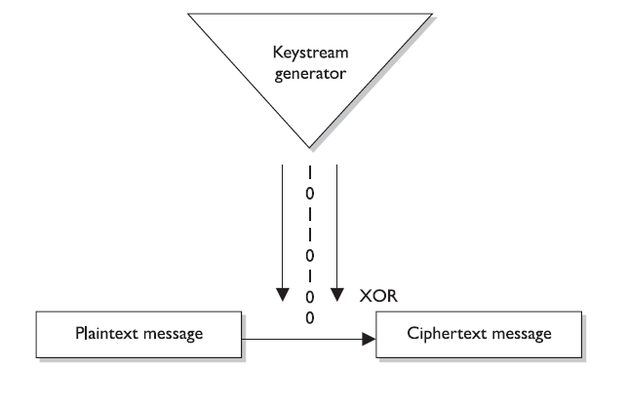
Stream Cipher

Slide 10
Stream Cipher
An attacker could get a copy of the plaintext and the resulting ciphertext, XOR them together and find the keystream to use in decrypting other messages.
A Key is usually used in stream cipher to provide the randomness to address this issue. So the stream of bits that are XORed with the plaintext is as random as possible.

Slide 11
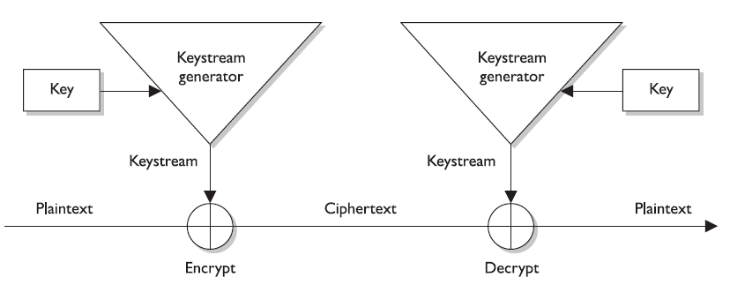
Stream Cipher

Slide 12
Block and Stream Cipher
Stream ciphers require a lot of randomness and encrypt individual bits at a time.
This require more processing power than block ciphers require which is why stream ciphers are better suited to be implemented at the hardware level.
Block ciphers do not require much processing power hence they are usually implemented at the software level
But these are just Best Practices.

Slide 13
Initialization Vector
Initialization Vectors(IVs) are random values that are used with algorithms to ensure patterns are not created during the encryption process.
They are used with keys and do not need to be encrypted when being sent to the destination.
If IVs are not used, then two identical plaintext values that are encrypted with the same key will create same ciphertext.
The IV and key are both used by algorithms to provide more randomness to encryption.

Slide 14
Data Encryption Standard(DES)
The Data Encryption Standard (DES) is a symmetric-key block cipher published by the National Institute of Standards and Technology (NIST).
With DES, a 64-bit block of plaintext goes into the algorithm and 64-bit of ciphertext comes out
Its uses the same 64-bit (56 bits is the true key length, 8-bits for parity) for both encryption and decryption.
When DES algorithm is applied to data, it divides the data into blocks and operate on them one at a time.
The blocks are put through 16 rounds of transpositions and substitution.
The encryption process is made of two permutations (P-boxes), which we call initial and final permutations, and sixteen Feistel rounds.

Slide 15
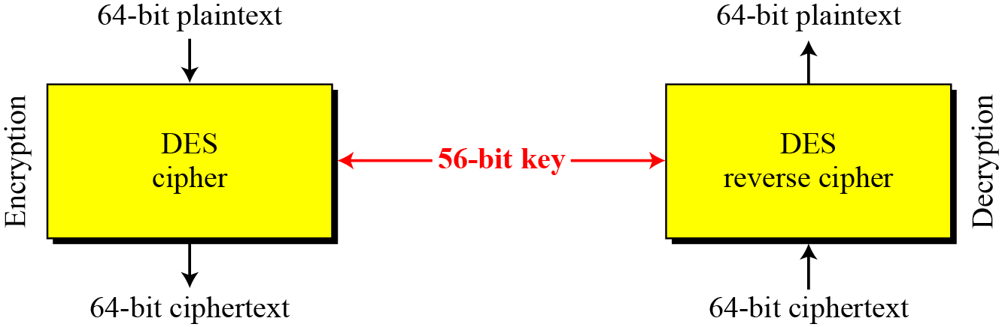
DES is a block cipher, as shown in the following Figure

Slide 16
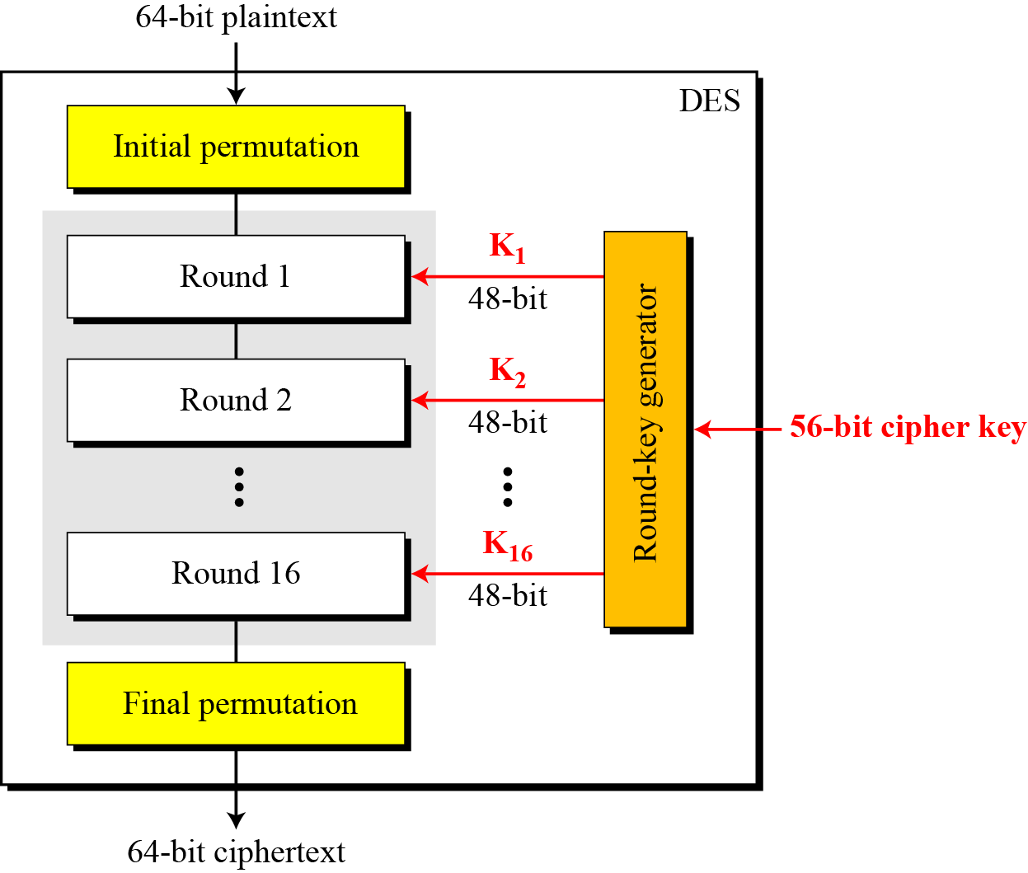
General structure of DES

Slide 17
DES Modes
Block cipher has several modes of operation.
DES and other symmetric block ciphers have several modes of operation that are used in different situations for different results.
Electronic Code Book (ECB)
Cipher Block Chaining (CBC)
Cipher Feedback Block(CFB)
Output Feedback Block (OFB)
Counter Mode (CTR)
Notes:
on

Slide 18
Advance Encryption Standard (AES)
A replacement for DES was needed
Key size is too small
NIST replaced DES in 1997 with AES
AES supports key/block sizes of 128, 192, and 256 bits.
If both the key and block are 128-bit size, then there are 10 rounds
If both the key and block are 192-bit size, then there are 12 rounds
If both the key and block are 256-bit size, then there are 14 rounds
Notes:
on

Slide 19
AES Conceptual Scheme
Plaintext (128 bits)
AES
Key (128-256 bits)
Ciphertext (128 bits)

Slide 20
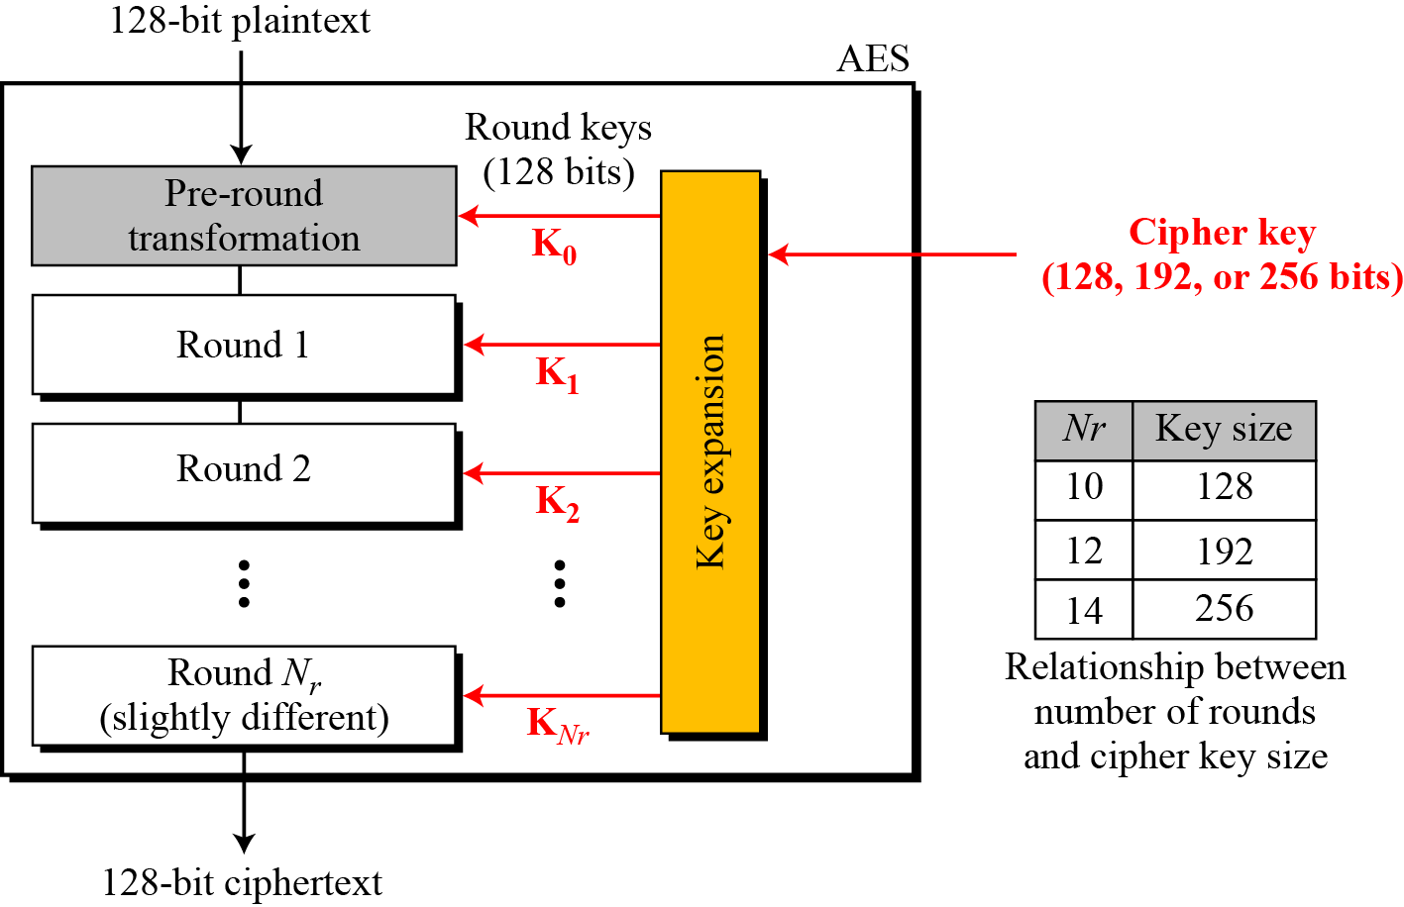
Multiple rounds
Rounds are (almost) identical
First and last round are a little different
Notes:
The input to the AES encryption and decryption algorithms is a single 128-bit block, depicted in FIPS PUB 197, as a square matrix of bytes .This block is copied into the State array, which is modified at each stage of encryption or decryption. After the final stage, State is copied to an output.
The key is expanded into 44/52/60 lots of 32-bit words (see later), with 4 used in each round.
The data computation then consists of an “add round key” step, then 9/11/13 rounds with all 4 steps, and a final 10th/12th/14th step of byte subs + mix cols + add round key. This can be viewed as alternating XOR key & scramble data bytes operations. All of the steps are easily reversed, and can be efficiently implemented using XOR’s & table lookups.

Slide 21
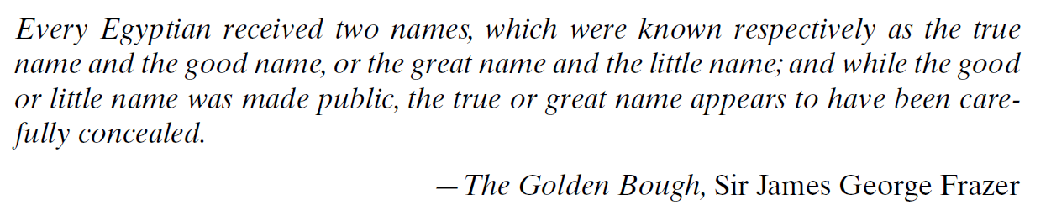

Slide 23
The development of public-key cryptography is the greatest and perhaps the only true revolution in the entire history of cryptography.
From its earliest beginnings to modern times, virtually all cryptographic systems have been based on the elementary tools of substitution and permutation.
After millennia of working with algorithms that could be calculated by hand, a major advance in symmetric cryptography occurred with the development of the rotor encryption/decryption machine.
With the availability of computers, even more complex systems were devised, the most prominent of which was the Lucifer effort at IBM that culminated in the Data Encryption Standard (DES).

Slide 24
Public-Key Cryptography
Uses two keys – a public & a private key
Asymmetric since parties are not equal
Uses clever application of number theoretic concepts to function
complements rather than replaces private key crypto

Slide 25
Public Key Cryptography
The mailbox analogy:
Bob has a locked mailbox
Alice can insert a letter into the box, but can’t unlock it to take mail out
Bob has the key and can take mail out
Encrypt messages to Bob with Bob’s public key
Can freely distribute
Bob decrypts his messages with his private key
Only Bob knows this

Slide 26
Public-Key Cryptography
public-key/two-key/asymmetric cryptography involves the use of two keys:
a public-key, which may be known by anybody, and can be used to encrypt messages, and verify signatures
a related private-key, known only to the recipient, used to decrypt messages, and sign (create) signatures
infeasible to determine private key from public key
is asymmetric because
those who encrypt messages or verify signatures cannot decrypt messages or create signatures
Notes:
26
Asymmetric algorithms rely on one key for encryption and a different but related key for decryption. These algorithms have the following important characteristic:
• It is computationally infeasible to determine the decryption key given only knowledge of the cryptographic algorithm and the encryption key.
In addition, some algorithms, such as RSA, also exhibit the following characteristic:
• Either of the two related keys can be used for encryption, with the other used for decryption.
Anyone knowing the public key can encrypt messages or verify signatures, but cannot decrypt messages or create signatures, thanks to some clever use of number theory.

Slide 27
Public-key algorithms are based on mathematical functions rather than on substitution and permutation.
Public-key cryptography is asymmetric, involving the use of two separate keys, in contrast to symmetric encryption, which uses only one key.
The use of two keys has profound consequences in the areas of confidentiality, key distribution, and authentication,

Slide 28
There are several misconceptions concerning public-key encryption.
One such misconception is that public-key encryption is more secure from cryptanalysis than is symmetric encryption. In fact, the security of any encryption scheme depends on the length of the key and the computational work involved in breaking a cipher. There is nothing in principle about either symmetric or public-key encryption that makes one superior to another from the point of view of resisting cryptanalysis.
A second misconception is that public-key encryption is a general-purpose technique that has made symmetric encryption obsolete. On the contrary, because of the computational overhead of public-key encryption schemes, there seems no foreseeable likelihood that symmetric encryption will be abandoned. As one of the inventors of public-key encryption has put it, “the restriction of public-key cryptography to key management and signature applications is almost universally accepted.”
Finally, there is a feeling that key distribution is trivial when using public key encryption, compared to the rather cumbersome handshaking involved with key distribution centers for symmetric encryption. In fact, some form of protocol is needed, generally involving a central agent, and the procedures involved are not simpler nor any more efficient than those required for symmetric encryption.

Slide 29
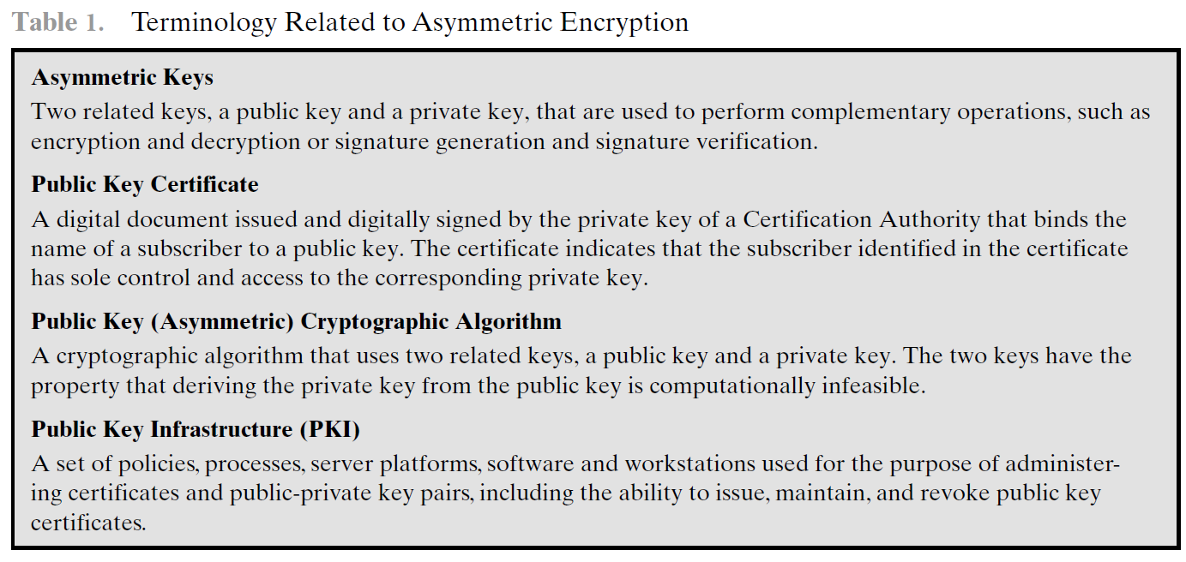

Slide 30
Why Public-Key Cryptography?
developed to address two key issues:
key distribution – how to have secure communications in general without having to trust a KDC with your key
digital signatures – how to verify a message comes intact from the claimed sender
public invention by Diffie and Hellman in 1976
known earlier in classified community
Notes:
30
The concept of public-key cryptography evolved from an attempt to attack two of the most difficult problems associated with symmetric encryption: key distribution and digital signatures. The first problem is that of key distribution, which under symmetric encryption requires either (1) that two communicants already share a key, which somehow has been distributed to them; or (2) the use of a key distribution center. This seemed to negated the very essence of cryptography: the ability to maintain total secrecy over your own communication. The second was that of "digital signatures." If the use of cryptography was to become widespread, not just in military situations but for commercial and private purposes, then electronic messages and documents would need the equivalent of signatures used in paper documents.
The idea of public key schemes, and the first practical scheme, which was for key distribution only, was published in 1976 by Diffie & Hellman. The concept had been previously described in a classified report in 1970 by James Ellis (UK CESG) - and subsequently declassified [ELLI99]. Its interesting to note that they discovered RSA first, then Diffie-Hellman, opposite to the order of public discovery! There is also a claim that the NSA knew of the concept in the mid-60’s [SIMM93].

Slide 31
The concept of public-key cryptography evolved from an attempt to attack two of the most difficult problems associated with symmetric encryption.
The first problem key distribution. Key distribution under symmetric encryption requires either
that two communicants already share a key, which somehow has been distributed to them; or
the use of a key distribution center. Whitfield Diffie, one of the discoverers of public-key encryption (along with Martin Hellman, both at Stanford University at the time), reasoned that this second requirement negated the very essence of cryptography: the ability to maintain total secrecy over your own communication. As Diffie put it , “what good would it do after all to develop impenetrable cryptosystems, if their users were forced to share their keys with a KDC that could be compromised by either burglary or subpoena?”
The second problem that Diffie pondered, and one that was apparently unrelated to the first, was that of digital signatures. If the use of cryptography was to become widespread, not just in military situations but for commercial and private purposes, then electronic messages and documents would need the equivalent of signatures used in paper documents. That is, could a method be devised that would stipulate, to the satisfaction of all parties, that a digital message had been sent by a particular person?

Slide 32

Asymmetric algorithms rely on one key for encryption and a different but related key for decryption. These algorithms have the following important characteristic.
• It is computationally infeasible to determine the decryption key given only knowledge of the cryptographic algorithm and the encryption key.
In addition, some algorithms, such as RSA, also exhibit the following characteristic.
Either of the two related keys can be used for encryption, with the other used for decryption.
A public-key encryption scheme has six ingredients
Plaintext: This is the readable message or data that is fed into the algorithm as input.

Slide 33
Encryption algorithm: The encryption algorithm performs various transformations on the plaintext.
Public and private keys: This is a pair of keys that have been selected so that if one is used for encryption, the other is used for decryption. The exact transformations performed by the algorithm depend on the public or private key that is provided as input.
Ciphertext: This is the scrambled message produced as output. It depends on the plaintext and the key. For a given message, two different keys will produce two different ciphertexts.
Decryption algorithm: This algorithm accepts the ciphertext and the matching key and produces the original plaintext.

Slide 34
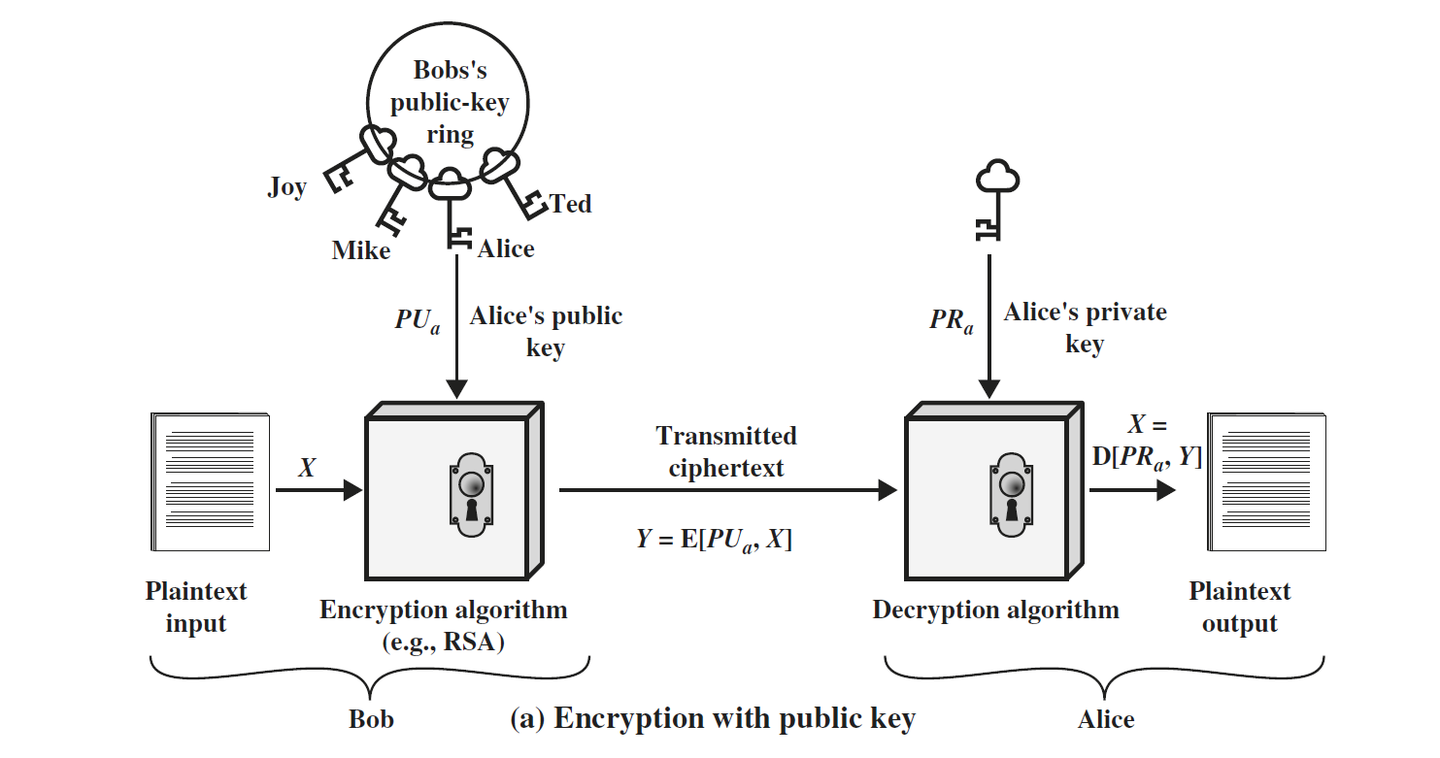

Slide 35
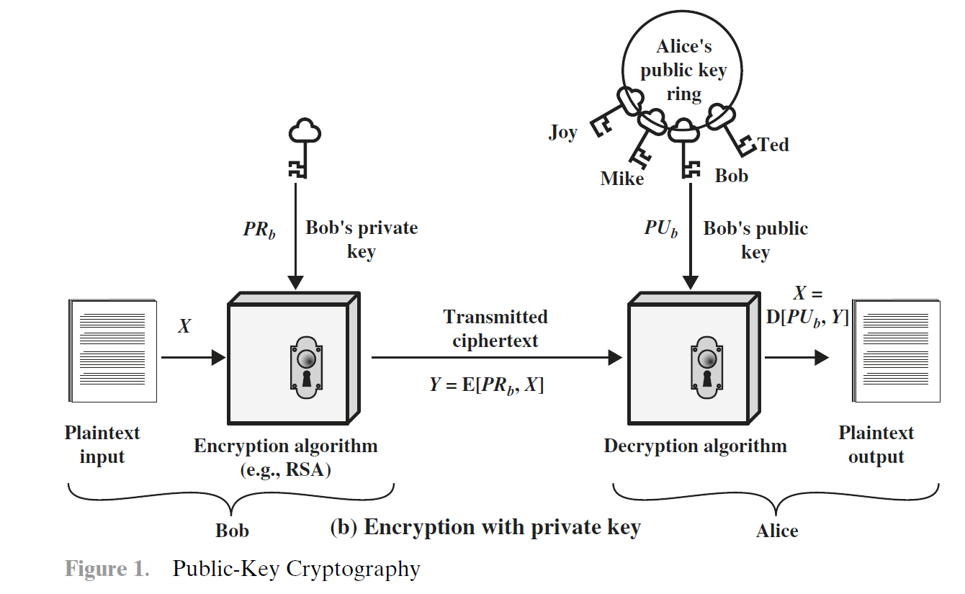

Slide 36
The essential steps are the following.
1. Each user generates a pair of keys to be used for the encryption and decryption of messages.
2. Each user places one of the two keys in a public register or other accessible file. This is the public key. The companion key is kept private. As suggested in the figure, each user maintains a collection of public keys obtained from others.
3. If Bob wishes to send a confidential message to Alice, Bob encrypts the message using Alice’s public key.
4. When Alice receives the message, she decrypts it using her private key. No other recipient can decrypt the message because only Alice knows Alice’s private key.

Slide 37
With this approach, all participants have access to public keys, and private keys are generated locally by each participant and therefore need never be distributed.
As long as a user’s private key remains protected and secret, incoming communication is secure. At any time, a system can change its private key and publish the companion public key to replace its old public key.
Table 2 summarizes some of the important aspects of symmetric and public key encryption. To discriminate between the two, we refer to the key used in symmetric encryption as a secret key. The two keys used for asymmetric encryption are referred to as the public key and the private key.2 Invariably, the private key is kept secret, but it is referred to as a private key rather than a secret key to avoid confusion with symmetric encryption.

Slide 38
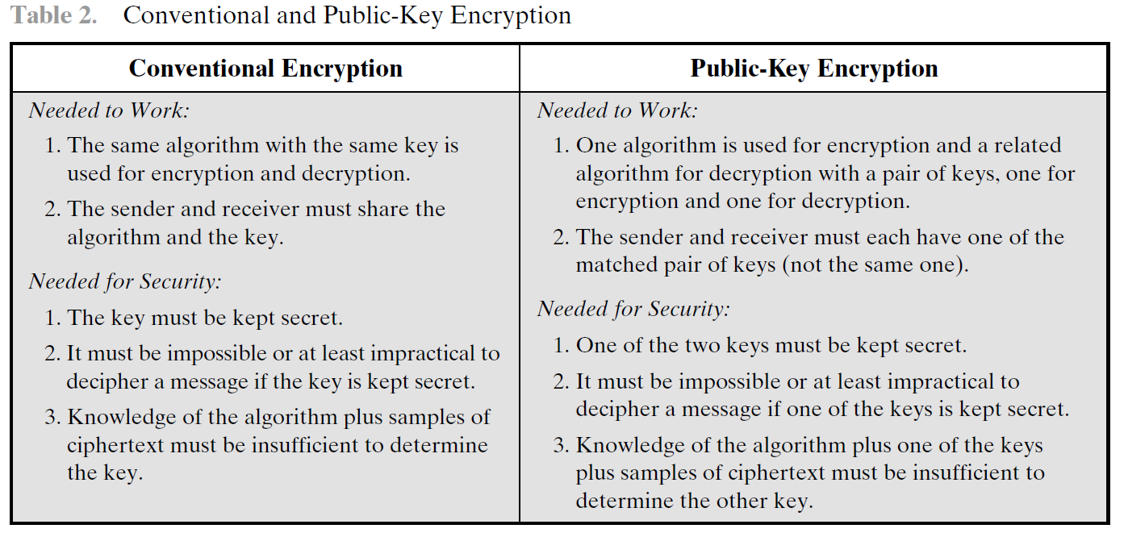

Slide 39
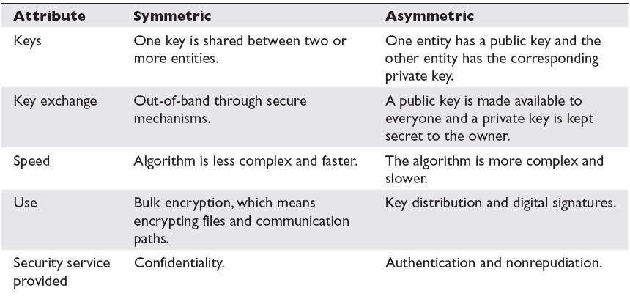

Slide 40
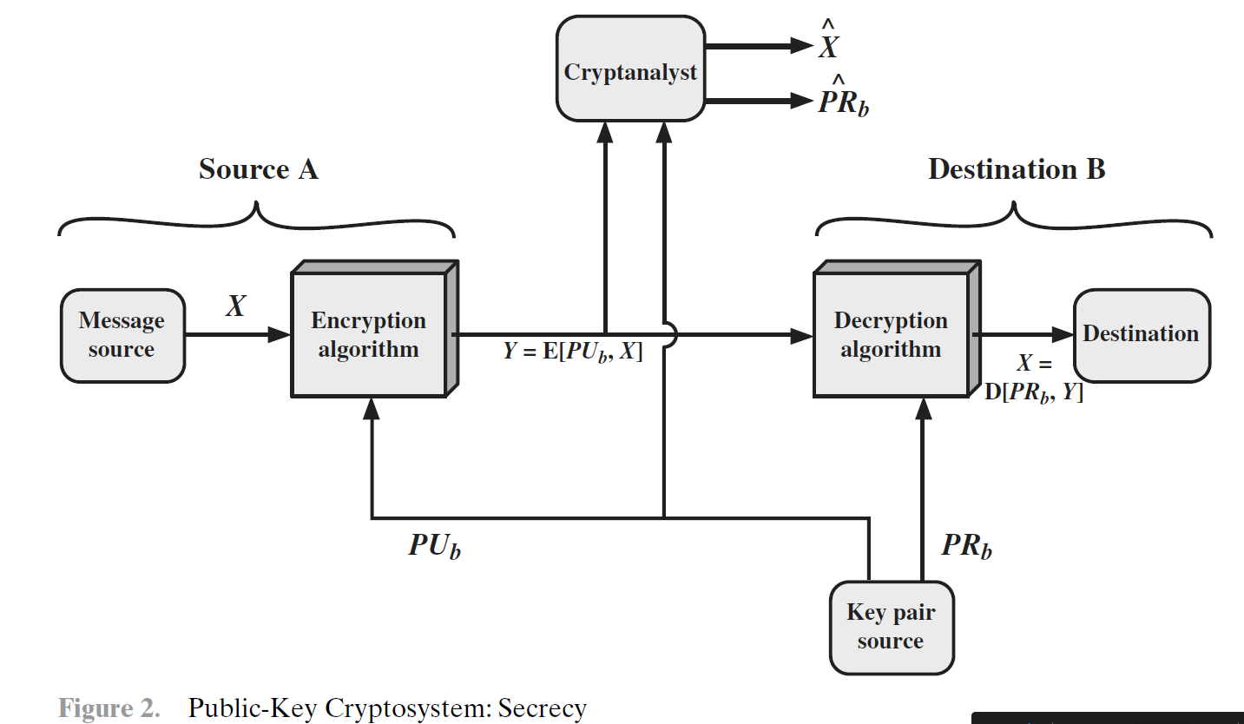

Slide 41
Let us take a closer look at the essential elements of a public-key encryption scheme, using Figure 2 (compare with Figure 2.2).
There is some source A that produces a message in plaintext, X = [X1, X2, … , XM]. The M elements of X are letters in some finite alphabet. The message is intended for destination B.
B generates a related pair of keys: a public key, PUb, and a private key, PRb. PRb is known only to B, whereas PUb is publicly available and therefore accessible by A.
With the message X and the encryption key PUb as input, A forms the ciphertext
Y = [Y1, Y2, … , YN]:
Y = E(PUb, X)
The intended receiver, in possession of the matching private key, is able to invert the transformation:
X = D(PRb,Y)

Slide 42
An adversary, observing Y and having access to PUb, but not having access to PRb or X, must attempt to recover X and/or PRb. It is assumed that the adversary does have knowledge of the encryption (E) and decryption (D) algorithms. If the adversary is interested only in this particular message, then the focus of effort is to recover X by generating a plaintext estimate X^ . Often, however, the adversary is interested in being able to read future messages as well, in which case an attempt is made to recover PRb by generating an estimate PR^ b.
We mentioned earlier that either of the two related keys can be used for encryption, with the other being used for decryption. This enables a rather different cryptographic scheme to be implemented. Public-key encryption to provide authentication:
Y = E(PRa,X)
X = D(PUa,Y)

Slide 43
In this case, A prepares a message to B and encrypts it using A’s private key before transmitting it. B can decrypt the message using A’s public key. Because the message was encrypted using A’s private key, only A could have prepared the message. Therefore, the entire encrypted message serves as a digital signature.
In addition, it is impossible to alter the message without access to A’s private key, so the message is authenticated both in terms of source and in terms of data integrity.
In the preceding scheme, the entire message is encrypted, which, although validating both author and contents, requires a great deal of storage. Each document must be kept in plaintext to be used for practical purposes. A copy also must be stored in ciphertext so that the origin and contents can be verified in case of a dispute.

Slide 44
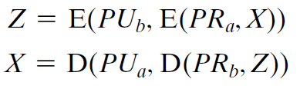
A more efficient way of achieving the same results is to encrypt a small block of bits that is a function of the document. Such a block, called an authenticator, must have the property that it is infeasible to change the document without changing the authenticator. If the authenticator is encrypted with the sender’s private key, it serves as a signature that verifies origin, content, and sequencing.
It is, however, possible to provide both the authentication function and confidentiality by a double use of the public-key scheme.

Slide 45
In this case, we begin as before by encrypting a message, using the sender’s private key. This provides the digital signature.
Next, we encrypt again, using the receiver’s public key. The final ciphertext can be decrypted only by the intended receiver, who alone has the matching private key. Thus, confidentiality is provided.
The disadvantage of this approach is that the public-key algorithm, which is complex, must be exercised four times rather than two in each communication.

Slide 46
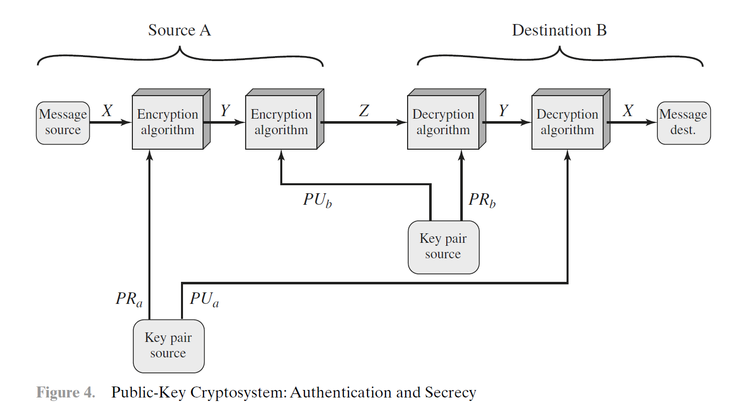

Slide 47
Public-key systems are characterized by the use of a cryptographic algorithm with two keys, one held private and one available publicly.
Depending on the application, the sender uses either the sender’s private key or the receiver’s public key, or both, to perform some type of cryptographic function.
In broad terms, we can classify the use of public-key cryptosystems into three categories
Encryption/decryption: The sender encrypts a message with the recipient’s public key.
Digital signature: The sender “signs” a message with its private key. Signing is achieved by a cryptographic algorithm applied to the message or to a small block of data that is a function of the message.
Key exchange: Two sides cooperate to exchange a session key. Several different approaches are possible, involving the private key(s) of one or both parties. Some algorithms are suitable for all three applications, whereas others can be used only for one or two of these applications. Table 3 indicates the applications supported by the algorithms discussed in this book.

Slide 48
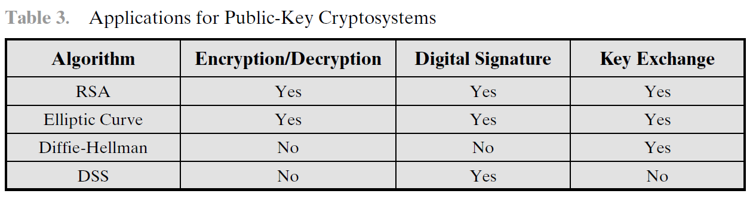

Slide 49
The cryptosystem depends on a cryptographic algorithm based on two related keys. Diffie and Hellman postulated this system without demonstrating that such algorithms exist. However, they did lay out the conditions that such algorithms must fulfill.
It is computationally easy for a party B to generate a pair (public key PUb, private key PRb).
It is computationally easy for a sender A, knowing the public key and the message to be encrypted, M, to generate the corresponding ciphertext:
C = E(PUb, M)
3. It is computationally easy for the receiver B to decrypt the resulting ciphertext using the private key to recover the original message:
M = D(PRb,C) = D[PRb, E(PUb,M)]
4. It is computationally infeasible for an adversary, knowing the public key, PUb, to determine the private key, PRb.

Slide 50
5. It is computationally infeasible for an adversary, knowing the public key, PUb, and a ciphertext, C, to recover the original message, M.
We can add a sixth requirement that, although useful, is not necessary for all
public-key applications:
6. The two keys can be applied in either order:
M = D[PUb, E(PRb, M)] = D[PRb, E(PUb, M)
The requirements above boil down to the need for a trap-door one-way function.
A one-way function is one that maps a domain into a range such that every function value has a unique inverse, with the condition that the calculation of the function is easy, whereas the calculation of the inverse is infeasible:

Slide 51
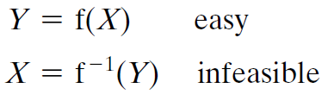
Generally, easy is defined to mean a problem that can be solved in polynomial time as a function of input length.
We can say a problem is infeasible if the effort to solve it grows faster than polynomial time as a function of input size.
Unfortunately, it is difficult to determine if a particular algorithm exhibits this complexity. Furthermore, traditional notions of computational complexity focus on the worst-case or average-case complexity of an algorithm. These measures are inadequate for cryptography, which requires that it be infeasible to invert a function for virtually all inputs, not for the worst case or even average case.

Slide 52
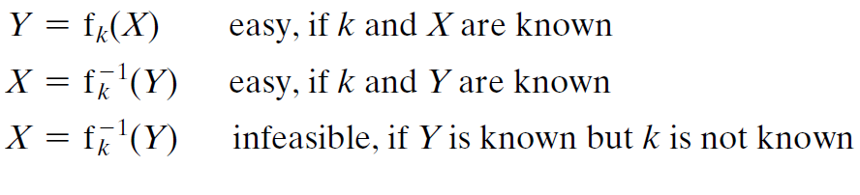
Trap-door one-way function
Are easy to calculate in one direction and infeasible to calculate in the other direction unless certain additional information is known.
With the additional information the inverse can be calculated in polynomial time. We can summarize as follows:
A trapdoor one-way function is a family of invertible functions fk, such that:
Thus, the development of a practical public-key scheme depends on discovery of a suitable trap-door one-way function.

Slide 53

As with symmetric encryption, a public-key encryption scheme is vulnerable to a brute-force attack. The countermeasure is the same: Use large keys. However, there is a tradeoff to be considered. Public-key systems depend on the use of some sort of invertible mathematical function. Thus, the key size must be large enough to make brute-force attack impractical but small enough for practical encryption and decryption.
Another form of attack is to find some way to compute the private key given the public key. To date, it has not been mathematically proven that this form of attack is infeasible for a particular public-key algorithm. Thus, any given algorithm, including the widely used RSA algorithm, is suspect.

Slide 54
Finally, there is a form of attack that is peculiar to public-key systems. This is, in essence, a probable-message attack. Suppose, for example, that a message were to be sent that consisted solely of a 56-bit DES key. An adversary could encrypt all possible 56-bit DES keys using the public key and could discover the encrypted key by matching the transmitted ciphertext. Thus, no matter how large the key size of the public-key scheme, the attack is reduced to a brute-force attack on a 56-bit key. This attack can be thwarted by appending some random bits to such simple messages.

Slide 55

One of the first successful responses to the cryptography challenge was developed in 1977 by Ron Rivest, Adi Shamir, and Len Adleman at MIT and first published in 1978.The Rivest-Shamir-Adleman (RSA) scheme has since that time reigned supreme as the most widely accepted and implemented general-purpose approach to public-key encryption.
The RSA scheme is a cipher in which the plaintext and ciphertext are integers between 0 and n - 1 for some n. A typical size for n is 1024 bits, or 309 decimal digits. That is, n is less than 21024.

Slide 56
Euler’s Totient
Totient function φ(n)
Number of positive numbers less than n that are relatively prime to n
Two numbers are relatively prime when their greatest common divisor is 1
Example: φ(10) = 4
1, 3, 7, 9
Example: φ(7) = 6
1, 2, 3, 4, 5, 6
If n is prime, φ(n) = n-1

Slide 57
RSA keys
Choose 2 large primes, p and q
N = pq
φ(N) = (p-1)(q-1)
Choose e < N such that gcd(e, φ(N))=1
d such that ed = 1 mod φ(N)
Public key: {N, e}
Private key: {d}
p and q must also be kept secret

Slide 58


RSA encryption/decryption
Alice wants to send Bob message m
She knows his public key, {N,e}
m = c^{d} mod N
c = m^{e} mod N
c
Bob
Alice

Slide 59
INPUT
FINISH
START
BigInteger -ProbablePrime
Message
“HI”
Message
“HI”
stringToNumber
numberToString
p
q
…
Calculate N and φ(N)
Calculate e and d
Message
7273
decrypt/
chineseRemainder
Public Keys
e N
Private Keys
d N
encrypt/
encryptSquare
Ciphertext
RSA Algorithm Flowchart
Notes:
59

Slide 60
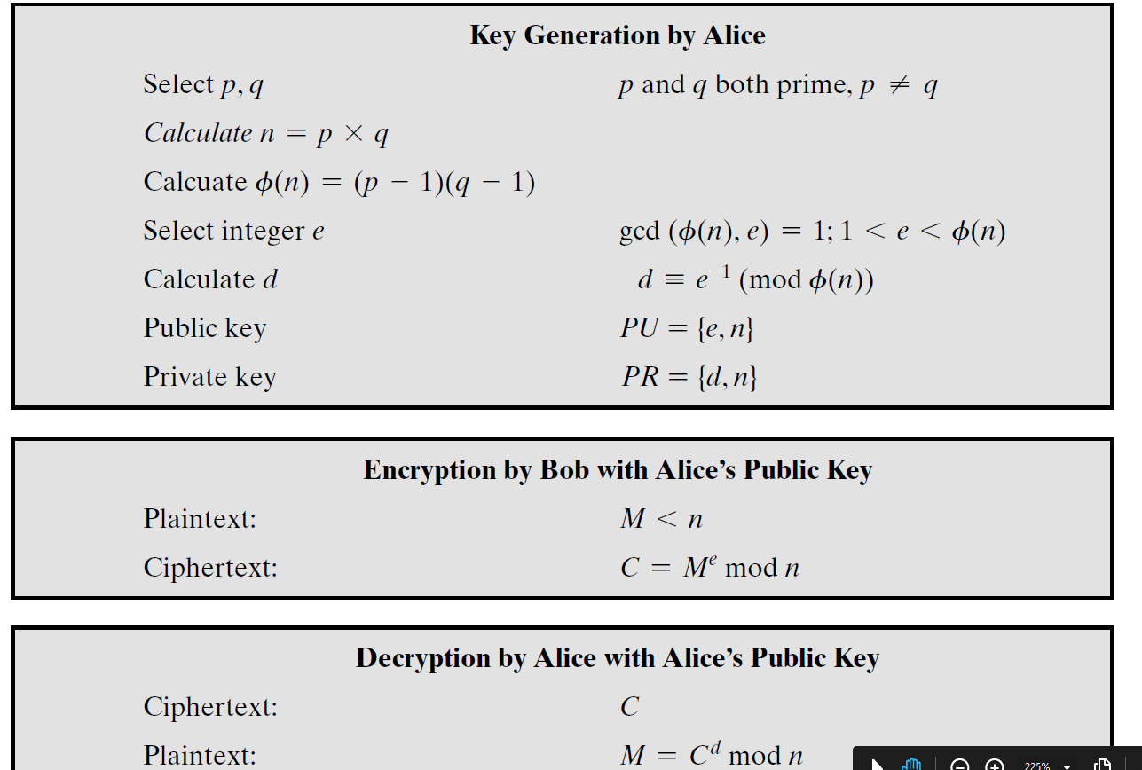

Slide 61
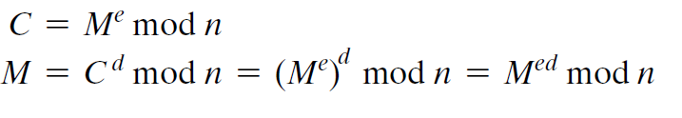
RSA makes use of an expression with exponentials. Plaintext is encrypted in blocks, with each block having a binary value less than some number n.
Encryption and decryption are of the following form, for some plaintext block M and ciphertext block C.
Both sender and receiver must know the value of n. The sender knows the value of e, and only the receiver knows the value of d. Thus, this is a public-key encryption algorithm with a public key of PU = {e, n} and a private key of PR = {d, n}.

Slide 62
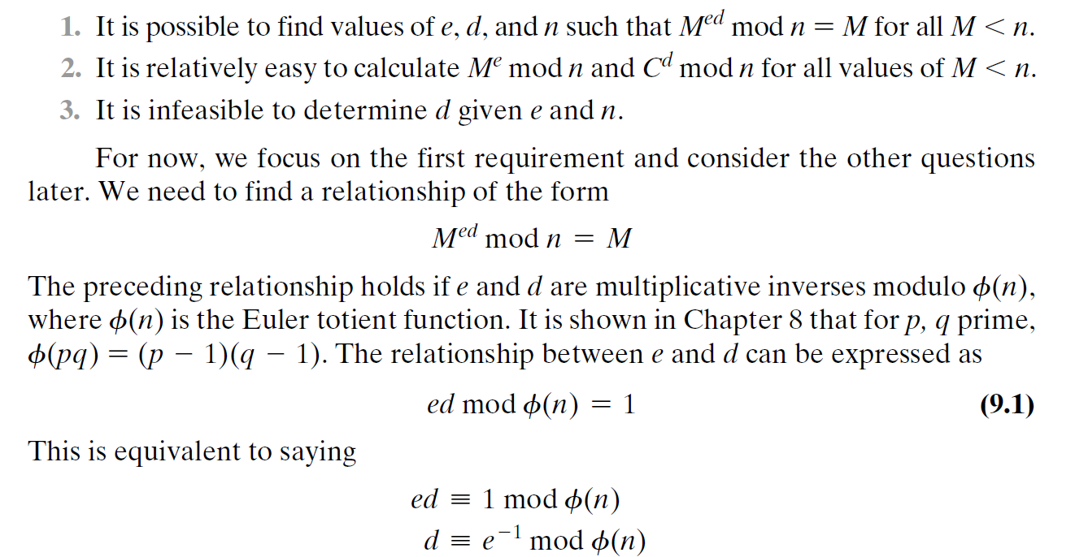
For this algorithm to be satisfactory for public-key encryption, the following requirements must be met.

Slide 63
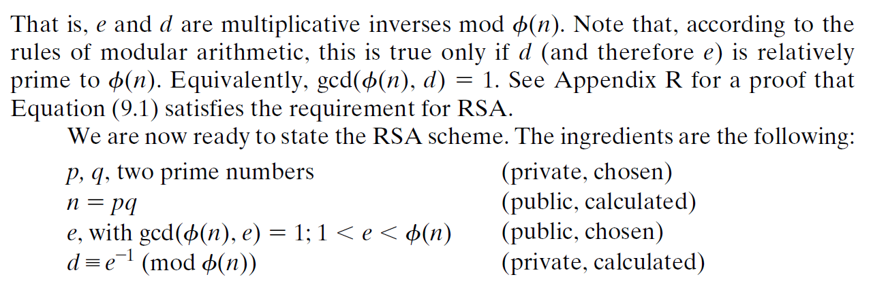
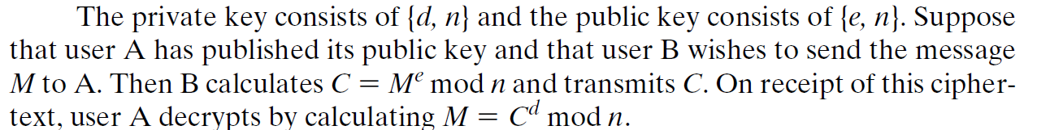

Slide 64
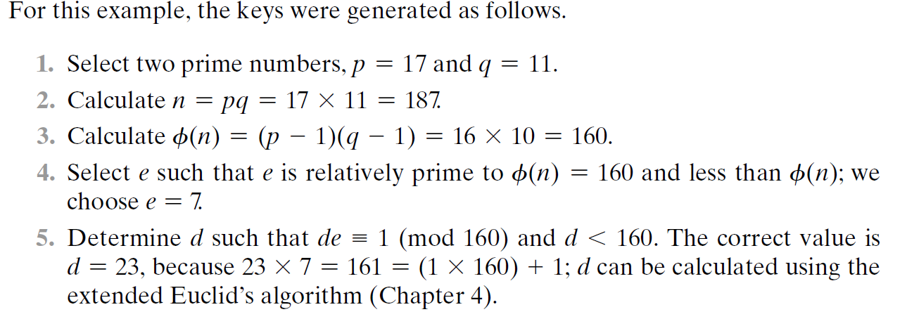
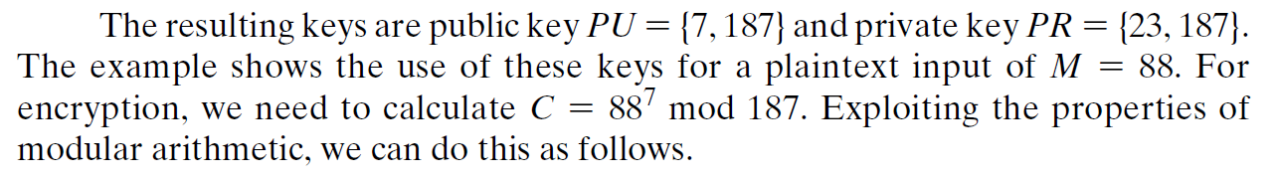

Slide 65
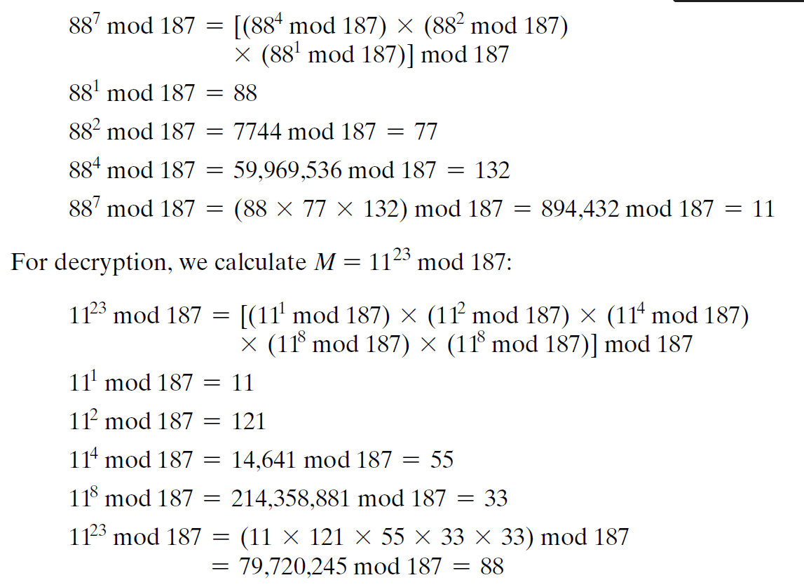

Slide 66
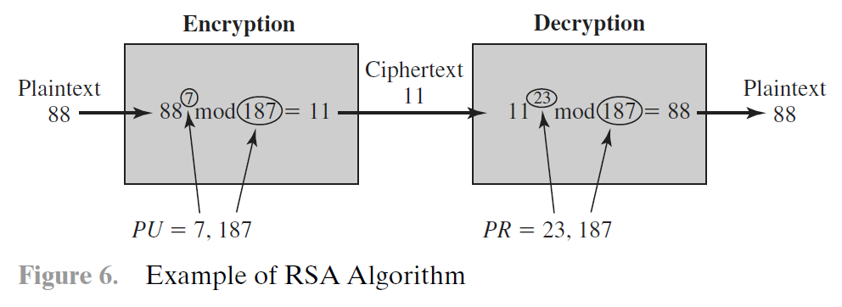

Slide 67
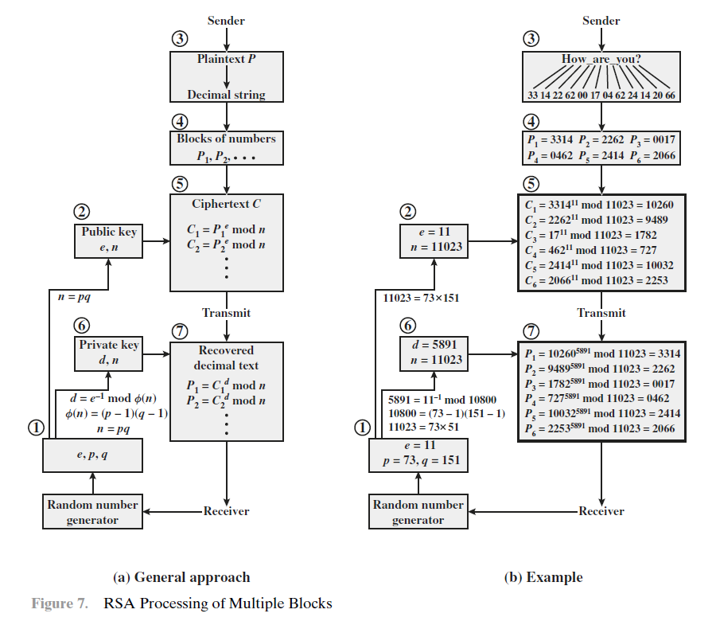

Slide 68

The issue of the complexity of the computation required to use RSA. There are actually two issues to consider: encryption/decryption and key generation.
Exponentiation in Modular Arithmetic
Both encryption and decryption in RSA involve raising an integer to an integer power, mod n. If the exponentiation is done over the integers and then reduced modulo n, the intermediate values would be gargantuan.
Another consideration is the efficiency of exponentiation, because with RSA, we are dealing with potentially large exponents.
Efficient operation using the public key
To speed up the operation of the RSA algorithm using the public key, a specific choice of e is usually made. The most common choice is 65537 (216 + 1); two other popular choices are 3 and 17. Each of these choices has only two 1 bits, so the number of multiplications required to perform exponentiation is minimized.

Slide 69
Efficient Operation Using the Private Key
We cannot similarly choose a small constant value of d for efficient operation. A small value of d is vulnerable to a brute-force attack and to other forms of cryptanalysis.
Key Generation
Before the application of the public-key cryptosystem, each participant must generate a pair of keys. This involves the following tasks.
Determining two prime numbers, p and q.
Selecting either e or d and calculating the other.
First, consider the selection of p and q. Because the value of n = pq will be known to any potential adversary, in order to prevent the discovery of p and q by exhaustive methods, these primes must be chosen from a sufficiently large set (i.e., p and q must be large numbers). On the other hand, the method used for finding large primes must be reasonably efficient.
At present, there are no useful techniques that yield arbitrarily large primes, so some other means of tackling the problem is needed.
The procedure that is generally used is to pick at random an odd number of the desired order of magnitude and test whether that number is prime. If not, pick successive random numbers until one is found that tests prime.

Slide 70
The procedure for picking a prime number is as follows.
1. Pick an odd integer n at random (e.g., using a pseudorandom number generator).
2. Pick an integer a < n at random.
3. Perform the probabilistic primality test, such as Miller-Rabin, with a as a parameter. If n fails the test, reject the value n and go to step 1.
4. If n has passed a sufficient number of tests, accept n; otherwise, go to step 2.
This is a somewhat tedious procedure. However, remember that this process is performed relatively infrequently: only when a new pair (PU, PR) is needed.

Slide 71

Five possible approaches to attacking the RSA algorithm are
Brute force: This involves trying all possible private keys.
Mathematical attacks: There are several approaches, all equivalent in effort to factoring the product of two primes.
Timing attacks: These depend on the running time of the decryption algorithm.
Hardware fault-based attack: This involves inducing hardware faults in the processor that is generating digital signatures.
Chosen ciphertext attacks: This type of attack exploits properties of the RSA algorithm.
The defense against the brute-force approach is the same for RSA as for other cryptosystems, namely, to use a large key space. Thus, the larger the number of bits in d, the better. However, because the calculations involved, both in key generation and in encryption/decryption, are complex, the larger the size of the key, the slower the system will run.

Slide 72
The Factoring Problem
There are three approaches to attacking RSA mathematically.
1. Factor n into its two prime factors. This enables calculation of φ(n) = (p - 1) *(q - 1), which in turn enables determination of d = e^-1 (mod φ(n)).
2. Determine φ(n) directly, without first determining p and q. Again, this enables determination of d = e^-1 (mod φ(n)).
3. Determine d directly, without first determining φ(n).

Slide 73
THANKS YOU

